Slide 1

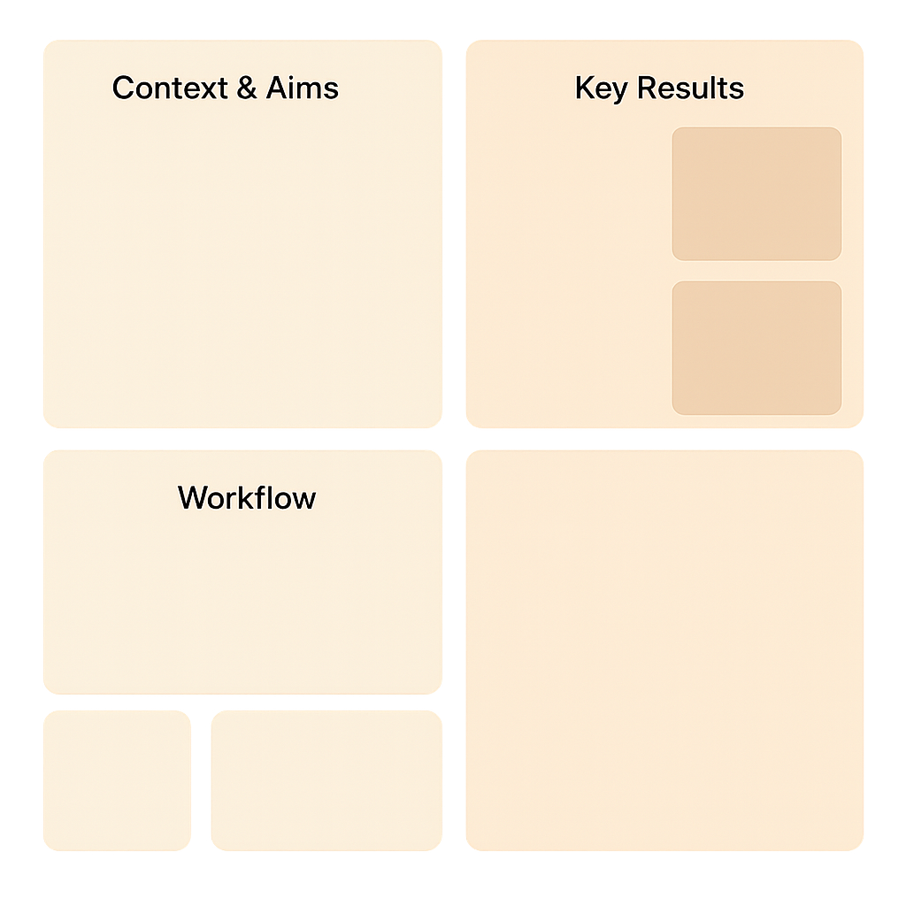


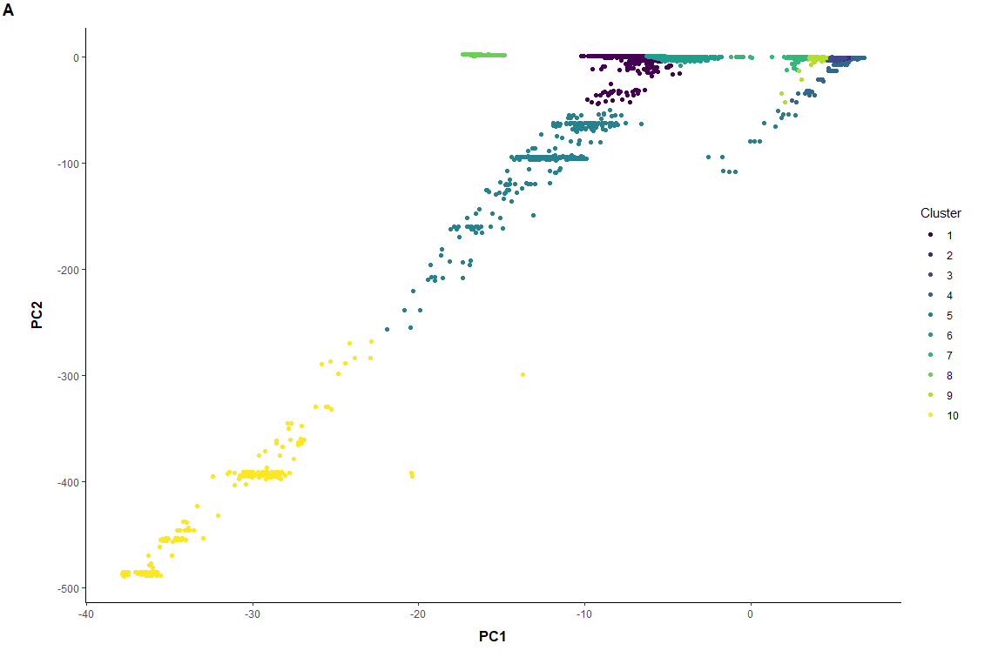
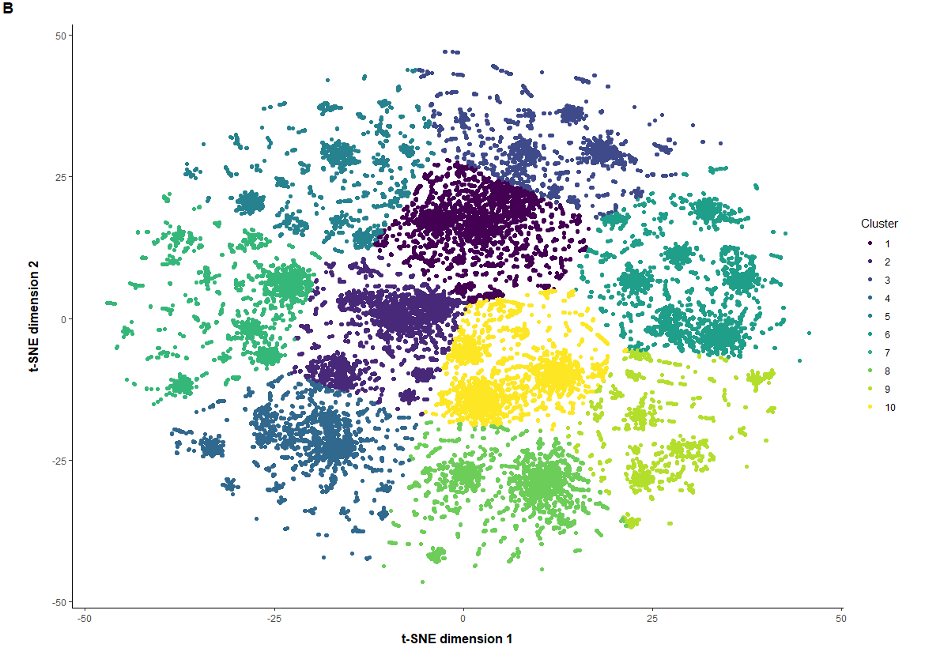
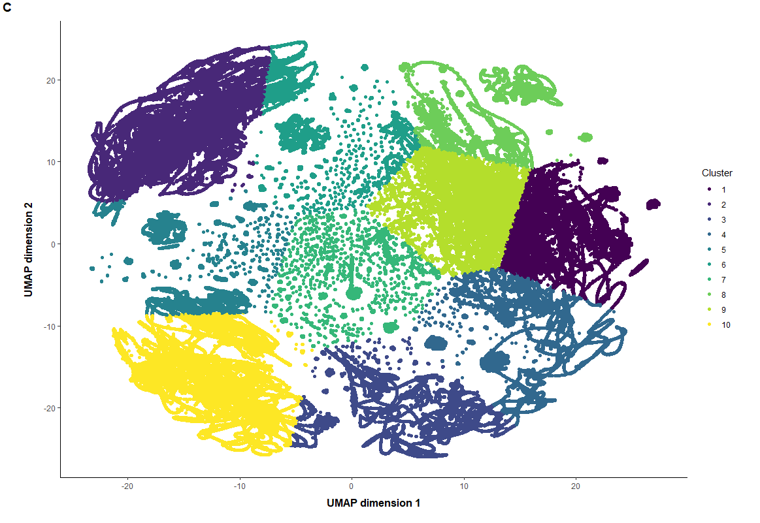
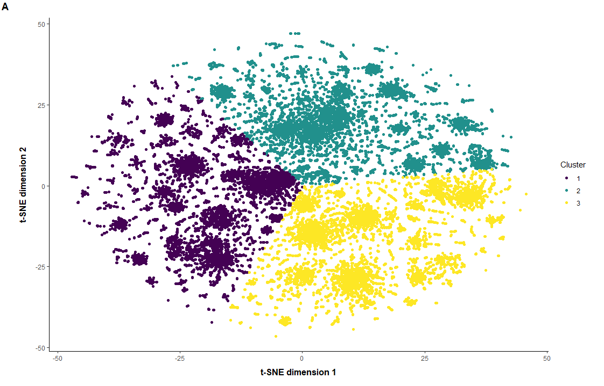

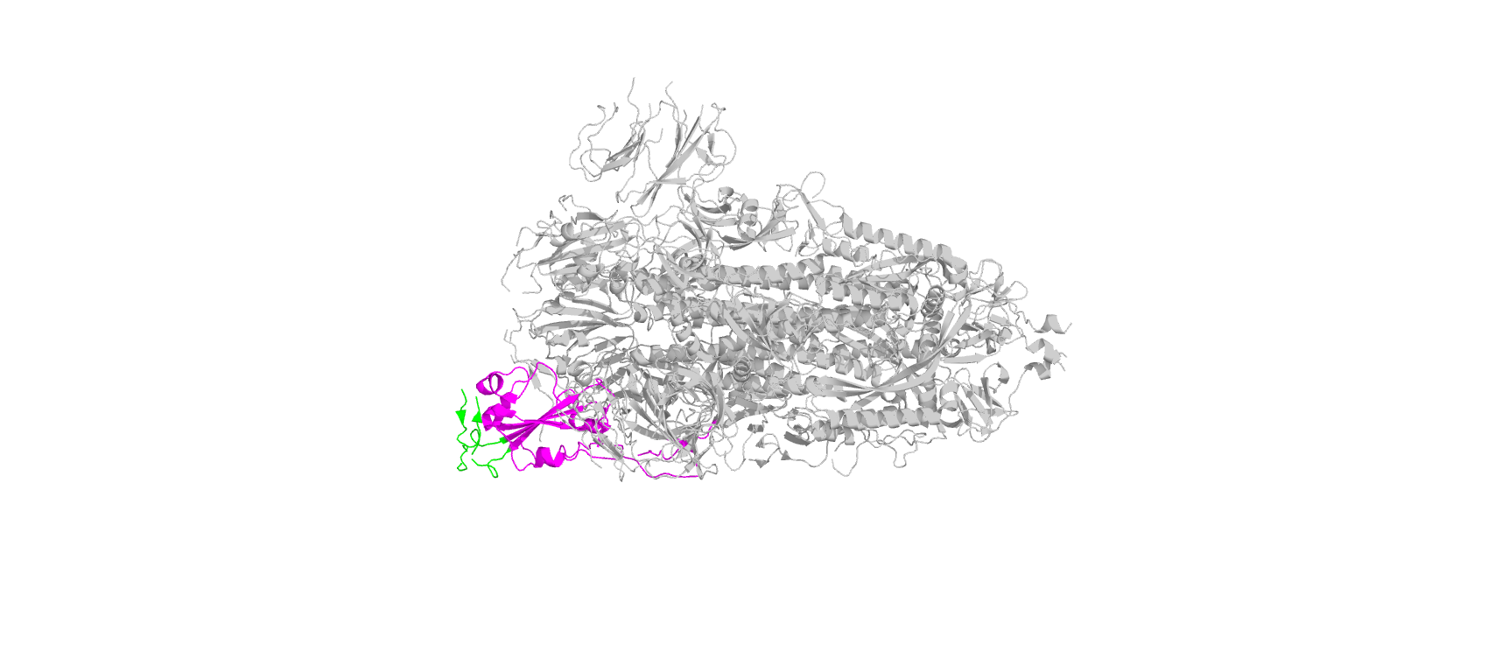




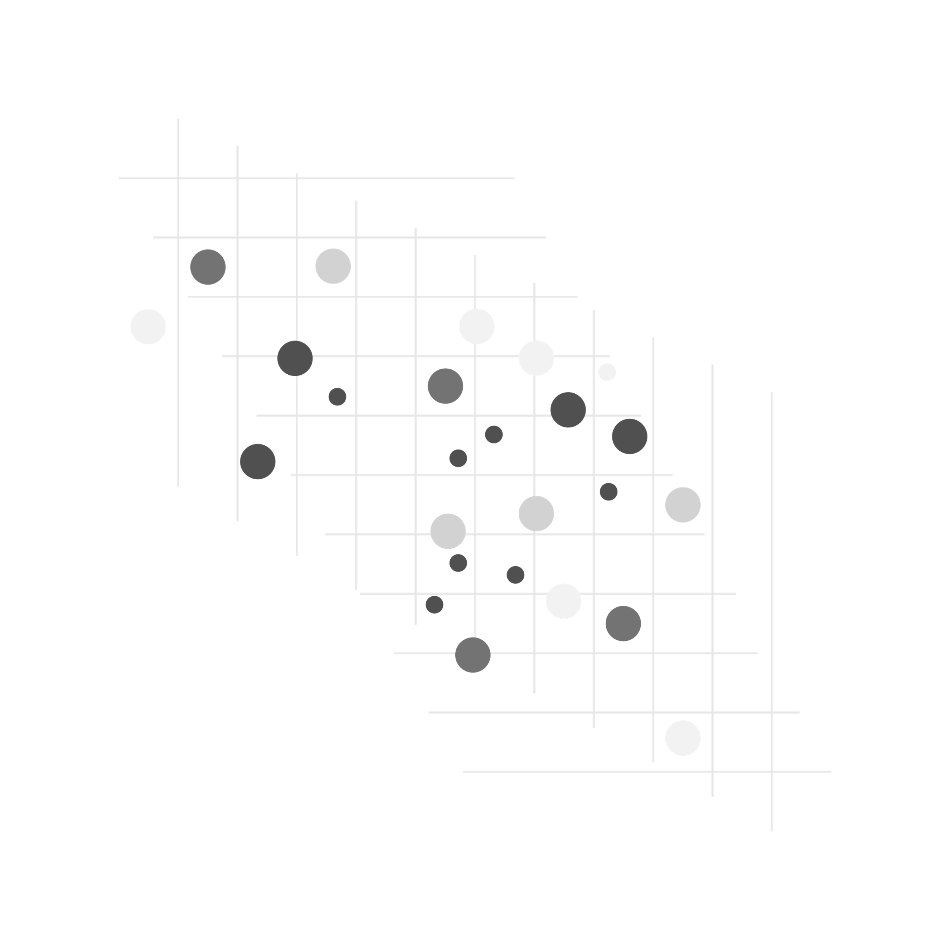





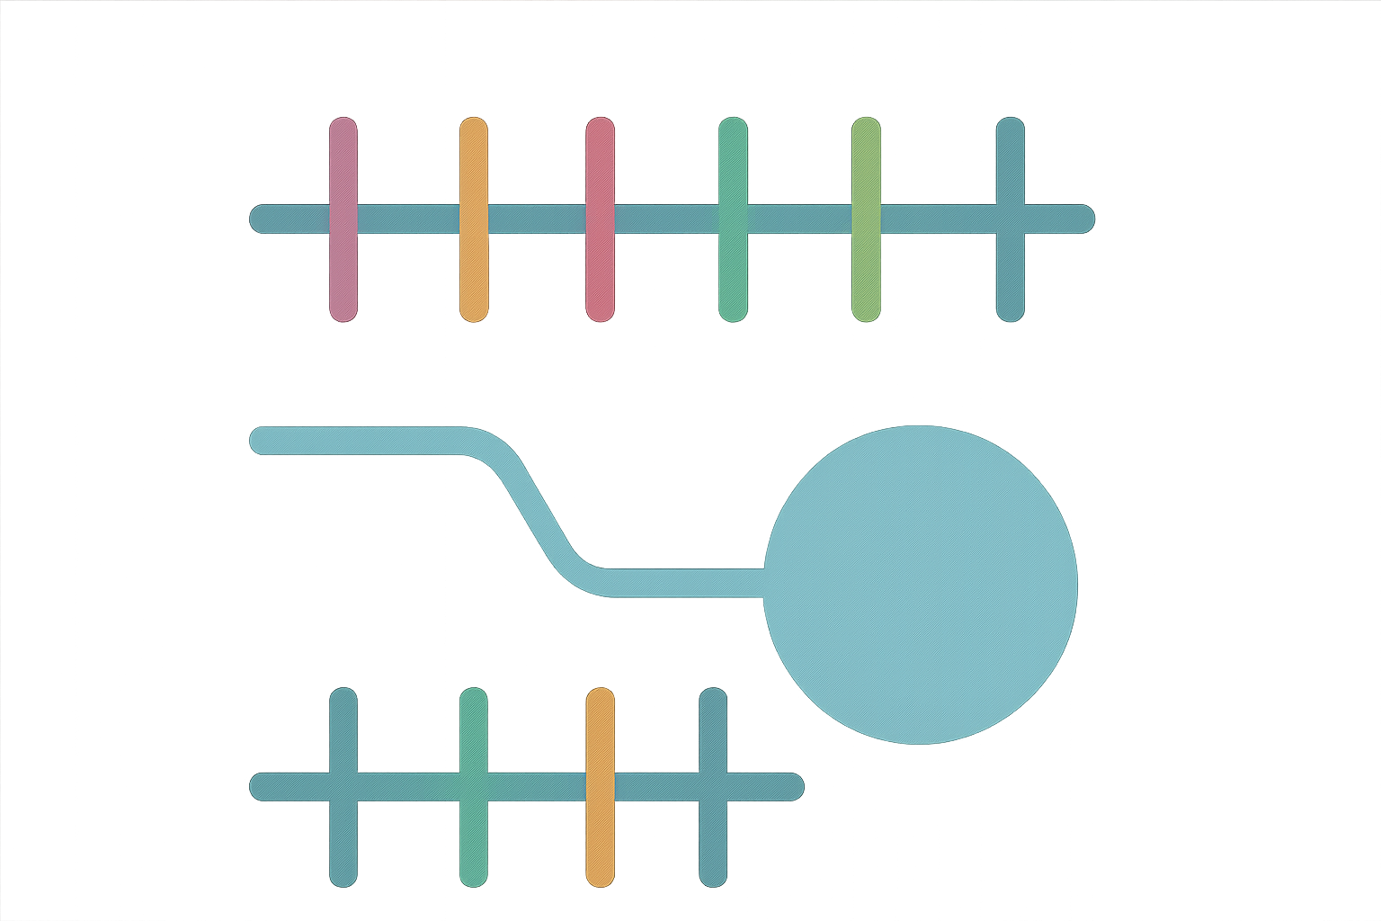
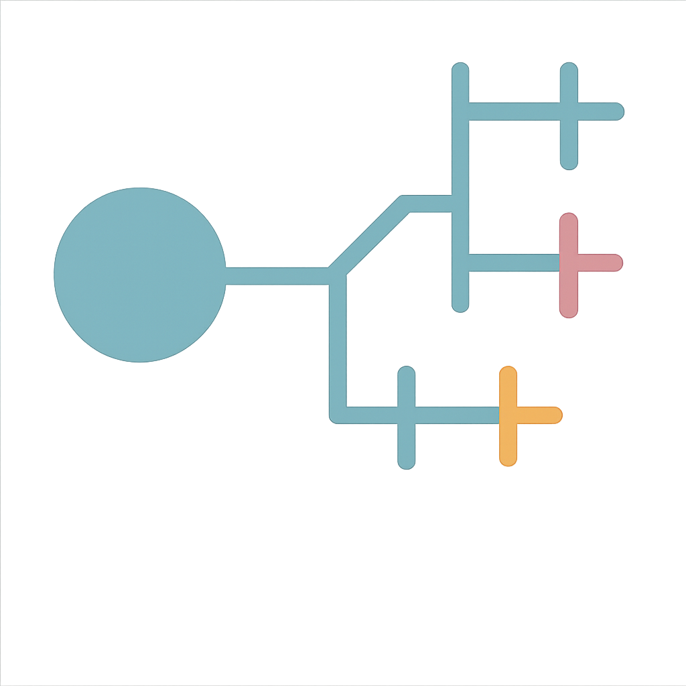
Analysing UK SARS-CoV-2 spike protein mutations via t-SNE paired with K-means clustering
Key results
Sam Aldous
Context & Aims
Over 6 hours
COVID-19 pandemic:
770,000,000 infections¹
Estimated death toll: 18,000,000 – 32,000,000²
Spike glycoprotein:
Receptor binding motif (RBM) residues bind directly to ACE2³
Receptor binding domain (RBD), two regions S1 & S2⁴
Infectivity:
RBD/RBM mutations modulate infectivity⁵
Examples: N501Y & D614G enhance affinity and stability changes⁶
How many key mutations occur in these regions may infer infectivity?
Aims:
Gaps remain in our understanding of SARS-CoV-2 clustering patterns in the UK and extracting meaningful information from large-scale datasets
Divulge temporal and general trends
Identify which dimensionality reduction technique best pairs with K-means clustering regarding efficiency and cluster clarity
Reveal dominant clusters and explore their infectivity & potential lineage from their centroids
1. Efficiency comparison:
Techniques | Reduction time | Clustering time (seconds) | Efficiency increase compared to K-means alone
Principal Component Analysis (PCA) | 1 hour 28 minutes | 69.98 | x4
t-distributed stochastic neighbour embedding (t-SNE) | 4 minutes | 3.60 | X1000
Uniform Manifold Approximation and Projection (UMAP) | 37 minutes | 36.00 | X9
2. 2D cluster visualisations:
PCA
t-SNE
Poor clustering
UMAP
Messy clustering
t-SNE
Good clustering
Workflow
3 clusters from elbow method
Data acquisition (GISAID)
3. Mutation profiling & lineages:
Spike protein 3D visualisation
Cluster | Key mutations | Infectivity | Lineage
I & II | L452R, P681R | Moderate | Delta
III | N501Y, D614G, E484A | High | Omicron
Dimensionality reduction
RBD
PCA
UMAP
t-SNE
Elbow method
4. Temporal & General trends:
15,213 unique mutations
Sequences accumulated mutations over time, 3 (2020) to 65 (2024) → Muller’s ratchet⁷
Strong positive correlation, ρ=0.895, p≪0.001
Cluster selection
RBM
Clusters I & II 2/10 mutations on the RBD/RBM
Cluster III 16/33 mutations on RBD & 8/33 on RBM
Mutation profiling
Conclusions and future work
Acknowledgements & References
t-SNE paired with K-means most efficient & most clear cluster visualisation
3 major cluster groups, I & II likely share a common ancestor
Cluster III highest proportion of RBD/RBM mutations reflects its adaptations for transmissibility, potentially the most infectious
Cluster & mutation profiling can guide future vaccine development
t-SNE assisted K-means clustering shows strong potential to deal with large-scale SARS-CoV-2 datasets
Estimated cumulative excess deaths during COVID-19 [Internet]. Our World in Data. [cited 2025 Feb 4]. Available from: https://ourworldindata.org/grapher/excess-deaths-cumulative-economist-single-entity?focus=~Confirmed+deaths
COVID-19 cases [Internet]. datadot. [cited 2025 Feb 21]. Available from: https://data.who.int/dashboards/covid19/cases?n=c
Chen J, Wang R, Wang M, Wei G-W. Mutations strengthened SARS-CoV-2 infectivity. J Mol Biol [Internet]. 2020 Sep 4;432(19):5212–26. Available from: http://dx.doi.org/10.1016/j.jmb.2020.07.009
McCallum M, Walls AC, Bowen JE, Corti D, Veesler D. Structure-guided covalent stabilization of coronavirus spike glycoprotein trimers in the closed conformation. Nat Struct Mol Biol [Internet]. 2020 Oct 4 [cited 2025 Feb 23];27(10):942–9. Available from: https://www.nature.com/articles/s41594-020-0483-8?fromPaywallRec=false
(5) Wang R, Chen J, Gao K, Hozumi Y, Yin C, Wei G-W. Analysis of SARS-CoV-2 mutations in the United States suggests presence of four substrains and novel variants. Commun Biol [Internet]. 2021 Feb 15 [cited 2024 Oct 27];4(1):228. Available from: https://www.nature.com/articles/s42003-021-01754-6
Liu Y, Liu J, Plante KS, Plante JA, Xie X, Zhang X, et al. The N501Y spike substitution enhances SARS-CoV-2 infection and transmission. Nature [Internet]. 2022 Feb;602(7896):294–9. Available from: http://dx.doi.org/10.1038/s41586-021-04245-0
Metzger JJ, Eule S. Distribution of the fittest individuals and the rate of Muller’s ratchet in a model with overlapping generations. PLoS Comput Biol [Internet]. 2013 Nov 7;9(11):e1003303. Available from: http://dx.doi.org/10.1371/journal.pcbi.1003303
Lineage assignment

